Slide 1
Competitive Programming
VS
Software Development

Slide 2
The Initial mind
Competitive Programming
Code chef, Top coder, Codeforces, Hacker Rank,
Software Development
Application, Mobile Apps, Front-End, Back-End

Slide 3
Skill Sets
Competitive Programming
Software Development
Programming Language
Mental ability
Complex thinking-analysis
Academic consistency
Efficient code writing practice
Complex logic building
Programming Language
Framework, Libraires, SDKS
Tools, Testing, Implementation
Project development, management, distribution
Business flow digitalization,
Process/service automation
Team management
Business/peoples demands needs.

Slide 4
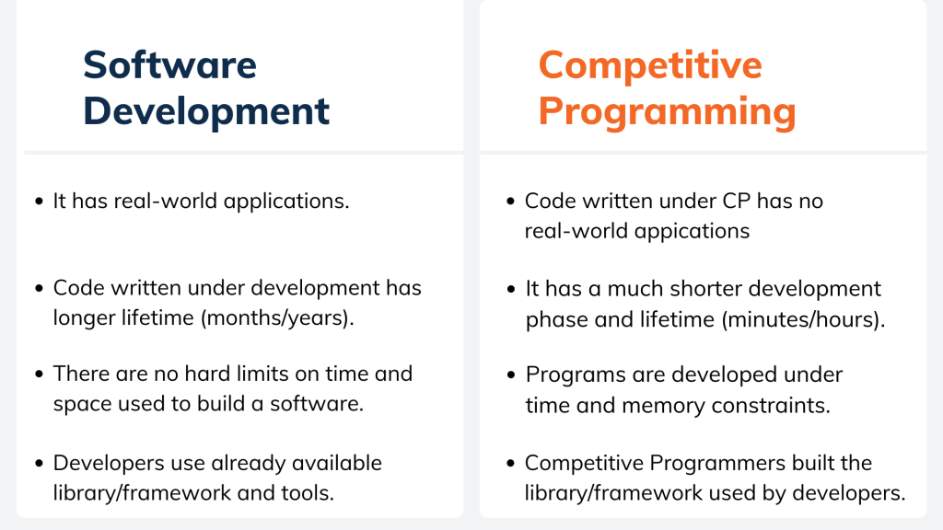
Key Difference

Slide 5
What software industry wants from you
Average
A decent coding background
Coding methodology, tool, library, or framework they need to work with.
Skilled developer who has worked on some projects and can kickstart
They care about their product, business, expansion
Google, Amazon, Microsoft, Apple, Facebook
The have complex solutions , billions of user’s around the world
The search for complex thinker
They need some competitive programmers
They also needs efficient software developer too

Slide 6
Learning Times, Curves, Responsibility conversion
Competitive
Programming
Software
Development

Slide 7
What about job interview for average company
Competitive
Programming
Software
Development

Slide 8
What about job interview for tech giant like Google
Competitive
Programming
Software
Development

Slide 9
Now decide where should you invest your time
Competitive
Programming
Software
Development

Slide 10
What in the future
Competitive
Programming
Software
Development

